Slide 1
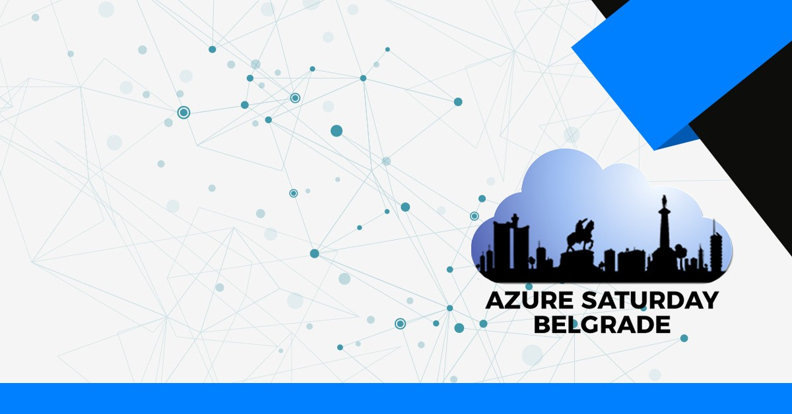
Run your largest workloads on Azure
Robert Boban, Senior Cloud Solution Architect – SAP and Azure, Microsoft Germany

Slide 2
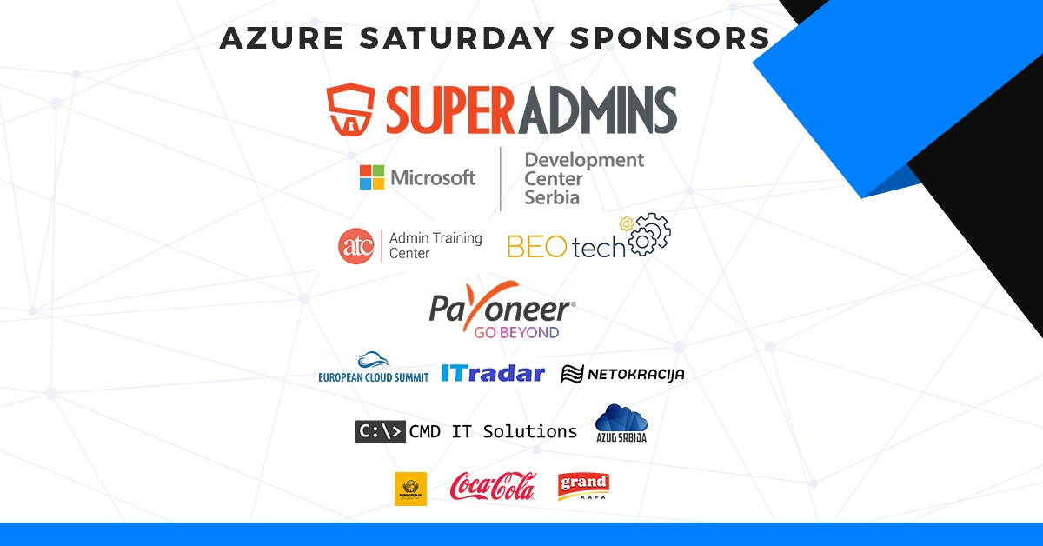

Slide 3
Microsoft Azure

Slide 4
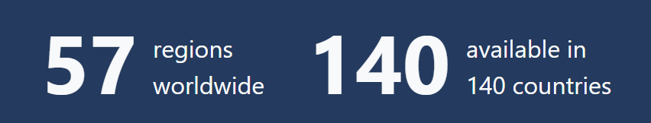
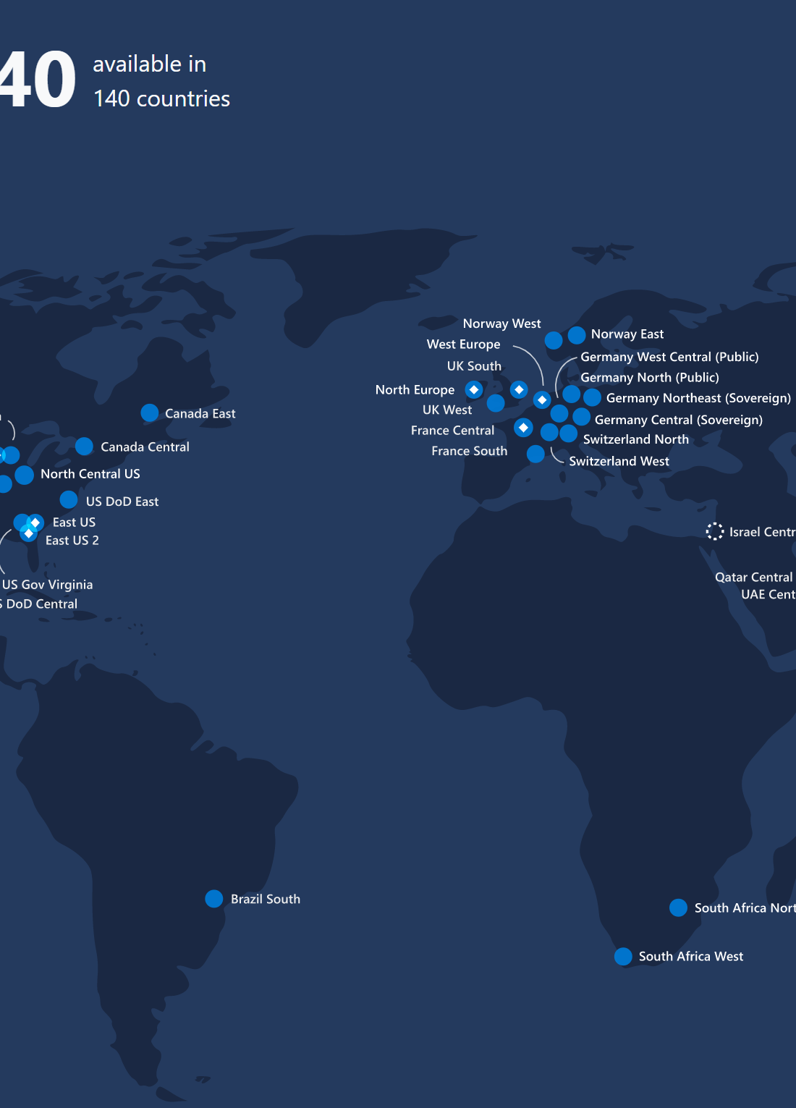
Azure global infrastructure
Regions
A region is a set of datacenters deployed within a latency-defined perimeter and connected through a dedicated regional low-latency network.
Europe
North Europe - Ireland
West Europe - Netherlands
France Central - Paris
France South - Marseille
UK West - Cardiff
UK South - London
trustee model
Germany Central - Frankfurt
Germany Northeast - Magdeburg
New…
Germany North - Berlin
Germany West Central - Frankfurt
Switzerland North - Zurich
Switzerland West - Geneva
Norway East - Norway
Norway West - Norway
azure.microsoft.com/global-infrastructure/regions/

Slide 5
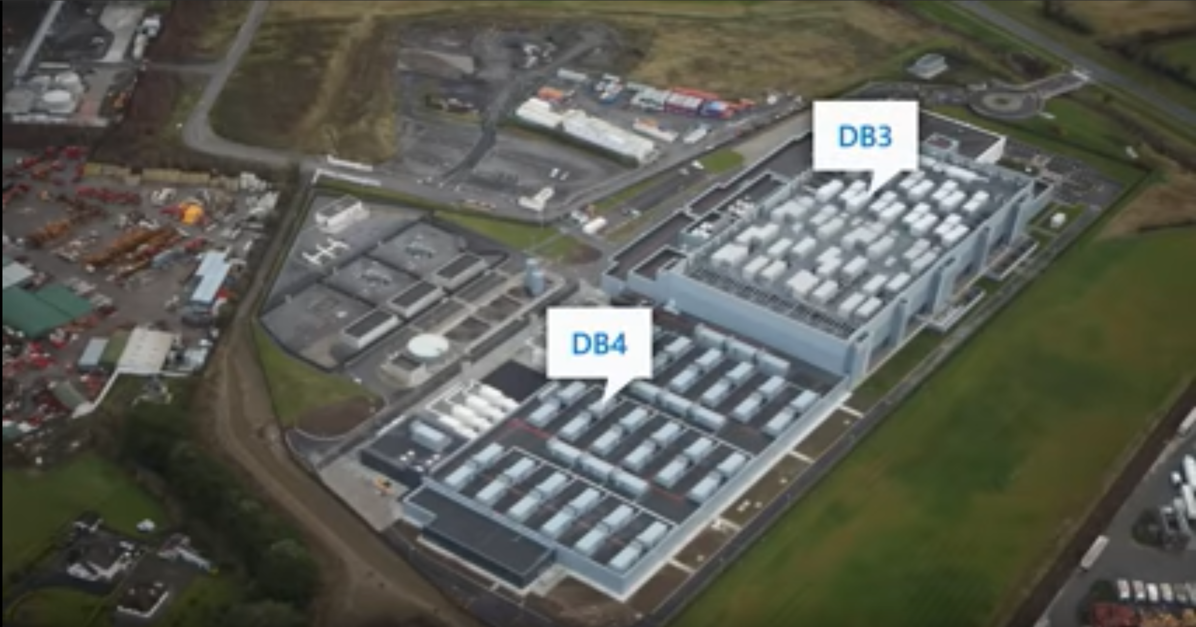
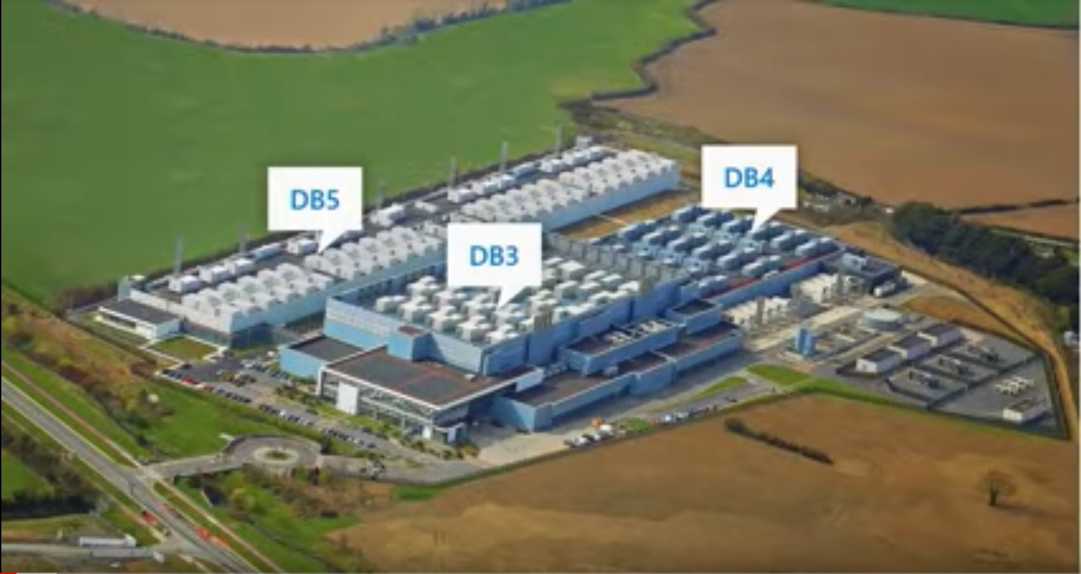
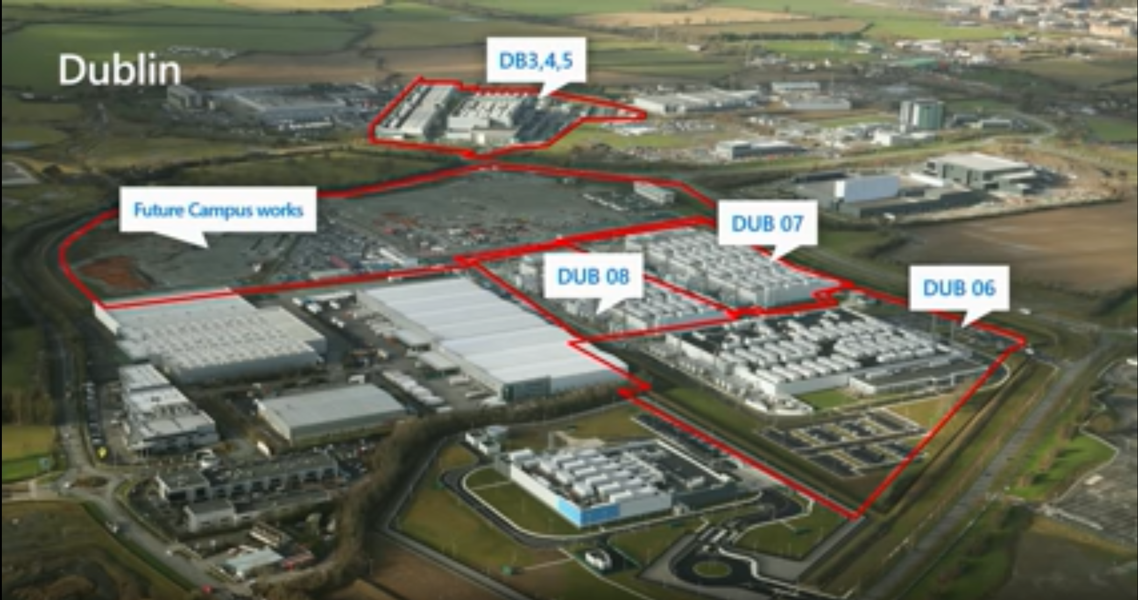

Slide 6
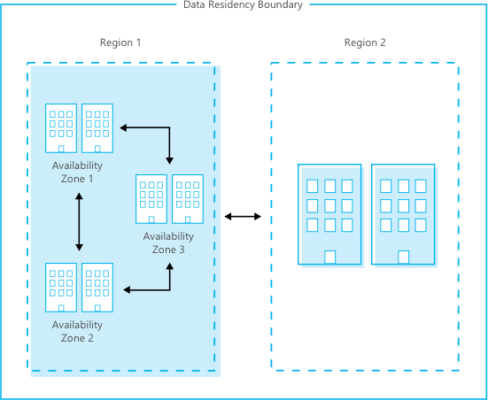
Understand Azure global infrastructure
Availability Zones
Availability Zones are physically separate locations within an Azure region.
Each Availability Zone is made up of one or more datacenters equipped with independent power, cooling, and networking.
Availability Zones allow customers to run mission-critical applications with high availability and low-latency replication.
azure.microsoft.com/global-infrastructure/availability-zones/

Slide 7
Azure covers 92 compliance offerings
Industry
Regional
US Gov
Global
Azure has the deepest and most comprehensive compliance coverage in the industry
ISO 27001:2013
ISO 27017:2015
ISO 27018:2014
ISO 22301:2012
ISO 9001:2015
ISO 20000-1:2011
SOC 1 Type 2
SOC 2 Type 2
SOC 3
CIS Benchmark
CSA STAR Certification
CSA STAR Attestation
CSA STAR self-assessment
WCAG 2.0 (ISO 40500:2012)
FedRAMP high
FedRAMP moderate
EAR
ITAR
DoD DISA SRG Level 5
DoD DISA SRG Level 4
DoD DISA SRG Level 2
DFARS
DoE 10 CFR Part 810
NIST SP 800-171
NIST CSF
Section 508 VPATs
FIPS 140-2
CJIS
IRS 1075
CNSSI 1253
PCI DSS Level 1
GLBA (US)
FFIEC (US)
Shared assessments (US)
SEC 17a-4 (US)
CFTC 1.31 (US)
FINRA 4511 (US)
SOX (US)
23 NYCRR 500 (US)
OSFI (Canada)
FCA + PRA (UK)
APRA (Australia)
FINMA (Switzerland)
FSA (Denmark)
RBI + IRDAI (India)
MAS + ABS (Singapore)
NBB + FSMA (Belgium)
AFM + DNB (Netherlands)
AMF + ACPR (France)
KNF (Poland)
European Banking Authority (EBA)
FISC (Japan)
HIPAA BAA (US)
HITRUST certification
GxP (FDA 21 CFR Part 11)
MARS-E (US)
NHS IG Toolkit (UK)
NEN 7510:2011 (Netherlands)
FERPA (US)
CDSA
MPAA (US)
FACT (UK)
DPP (UK)
TISAX (Germany)
Argentina PDPA
Australia IRAP Unclassified
Australia IRAP PROTECTED
Canada Privacy Laws
China GB 18030:2005
China DJCP (MLPS) Level 3
China TRUCS/CCCPPF
EU EN 301 549
EU ENISA IAF
EU model clauses
EU—US privacy shield
GDPR
Germany C5
Germany IT— Grundschutz workbook
India MeitY
Japan CS mark gold
Japan my number act
Netherlands BIR 2012
New Zealand Gov CIO Framework
Singapore MTCS Level 3
Spain ENS High
Spain DPA
UK cyber essentials plus
UK G-Cloud
UK PASF
Korea K-ISMS
France HDS
https://aka.ms/AzureCompliance
Notes:
Newly added as of Dec-2018: TISAX (Germany) under Industry; Added Korea K-ISMS and France HDS under Regional
See https://aka.ms/AzureCompliance for more information.

Slide 8
Enterprise-Grade VM Availability, SLAs & DR
VM SLA
VM SLA
VM SLA
Multi-region
99.9%
99.95%
99.99%
Data Resiliency
Data residency
Single VM
Availability sets
Availability zones
Region pairs
Easier lift and shift
Protecting against failures within datacenters
Protection from entire datacenter failures
Regional protection within Data Residency Boundaries

Slide 9
SAP HANA on Azure
SCALE-UP
OPTANE
OPTANE
192GB
256GB
512GB
768GB
1TB
1.5TB
1.7TB
2TB
2TB
3TB
4TB
4TB
6TB
6TB
8TB
9TB
12TB
12TB
16TB
18TB
20TB
24TB
OLAP/ OLTP
OLTP
HANA Virtual Machine
HANA Large Instance
https://azure.microsoft.com/en-au/solutions/sap/
Notes:
Azure offers the range of instance sizes and capabilities so you can have confidence in the ability to meet changing needs of your business. A key benefit for HANA on Azure is that you can easily move between instance sizes – scaling capacity to requirements. With Large Instances, you can more easily scale to meet CPU, and RAM requirements – for example, a 4TB OLAP capability.

Slide 10

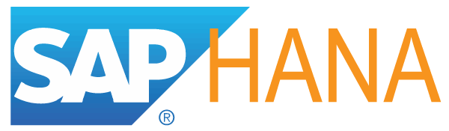
SAP on Azure - Large variety of instances
NetWeaver
Certified
HANA
Certified
A
D
F
G
M
Dv3
Ev3
G
A
Av2
Dv2
General purpose
workloads
Compute intensive
workloads
Memory optimized for Dev/Test & PoC HANA workloads
Memory optimized for Dev/Test & PoC HANA workloads
Optimized for large production SAP HANA workloads
Purpose built instance for largest SAP HANA production workloads
HIGHEST VALUE
LARGEST SCALE-UP
MAX:
vCPUs
16 | 16 | 64 | 64 | 32 | 128 | 960
112 | 56 | 256 | 432 | 448 | 11500 | 22350
RAM (GiB)
Notes:
Product leadership – I want to talk to you about our SAP offering for Azure
-G-series these are our smaller machines for dev/test and PoC’s. Scale them up or down, turn the on or off on demand.
-M for most implementations
-Large Instance goes up to 20 TB for OLTP. No one has this – Most you can get from Amazon is 6 TB
-Do you get the feeling that we serious about the SAP space?
-Remember we are the only cloud provider that runs SAP in our cloud.
-Its also worth pointing out that the specifications we give to HP and other hardware providers are higher than industry standards
Additional Information (for background)
Your choice of VMs generally represent a combination of:
Number of vCPUs,Memory, Local Storage (DB caching), Persistent Storage, Network and Storage bandwidths.
A-series VMs are best suited for entry level workloads like development and test. Good for App Servers.
Example use cases include Netweaver training systems or dev/test systems in 2-tier.
For Non Production all of these machine types can be used. Only some are certified by SAP for Production however we are both working together on certification all the time.
For Production application and DB server for Netweaver based systems, We recommend DV2.
Dv3 instances are the latest generation of general purpose instances. Ev3 instances are based on the 2.3 GHz Intel XEON® E5-2673 v4 (Broadwell) processor. You can attach up to 64 Disks. These new sizes introduce Hyper-Threading Technology running on the Intel® Broadwell E5-2673 v4 2.3GHz processor, and the Intel® Haswell 2.4 GHz E5-2673 v3. These new Hyper-Threaded sizes will be priced up to 28% lower than the previous Dv2 sizes.
G-series VMs feature the latest Intel® Xeon® processor E5 v3 family, two times more memory, and four times more Solid State Drive storage (SSDs) than the General Purpose D-series. (6 TB of local storage).
M-series virtual machines feature Intel® Xeon® E7-8890 v3 2.5GHz (Haswell) processor. The M-series provides up to 128 cores and 3.8 TiB of memory, with support for up to 64 disks.

Slide 11
SAP on Azure - Scenarios and Benefits
Development and Test
Production environments
Disaster Recovery
Archiving
Archive data and the corresponding SAP systems audit-proof without running costs and always available
Quick provisioning of development and test environments with the ability to stop the environments any time
“All in”. Deploy entire SAP system landscapes to Azure and deliver on cloud-first vision
Keep environments for recovery purposes without additional cost
Notes:
DR – only cost is DB instance – keeping it in sync….
Provisioing of systems – down from 3 weeks to 53 minutes….

Slide 12


Journey to SAP HANA and Azure
On-premises
Multi-Vendor
Lift and Shift to Cloud
SAP AnyDB on Azure
S/4HANA on Azure
A
Migration to HANA, Conversion to S/4HANA
Non-SAP,
Custom
SAP HANA on Azure
Analytics
Lift and Migrate to Cloud
Analytics
Non-SAP, Custom
B
Migrate to HANA
Non-SAP,
Custom
Industry solutions
ERP,
Industry Add-ons
Conversion to S/4HANA or BW/4HANA
Non-SAP
Analytics
Any DB
Embedded analytics
ERP,
Industry Add-ons
ERP,
Industry Add-ons
C
Lift and Shift/Migrate to Cloud, Migrate part to HANA
S/4HANA
HANA
D
Transformation to S/4HANA and Cloud: Consolidation or (selective) Re-implementation or Greenfield
Any DB
HANA
SAP SaaS
HEC, SCP, SuccessFactors, Concur, C/4Hana (Hybris +)

Slide 13
Something about Azure projects today…

Slide 14
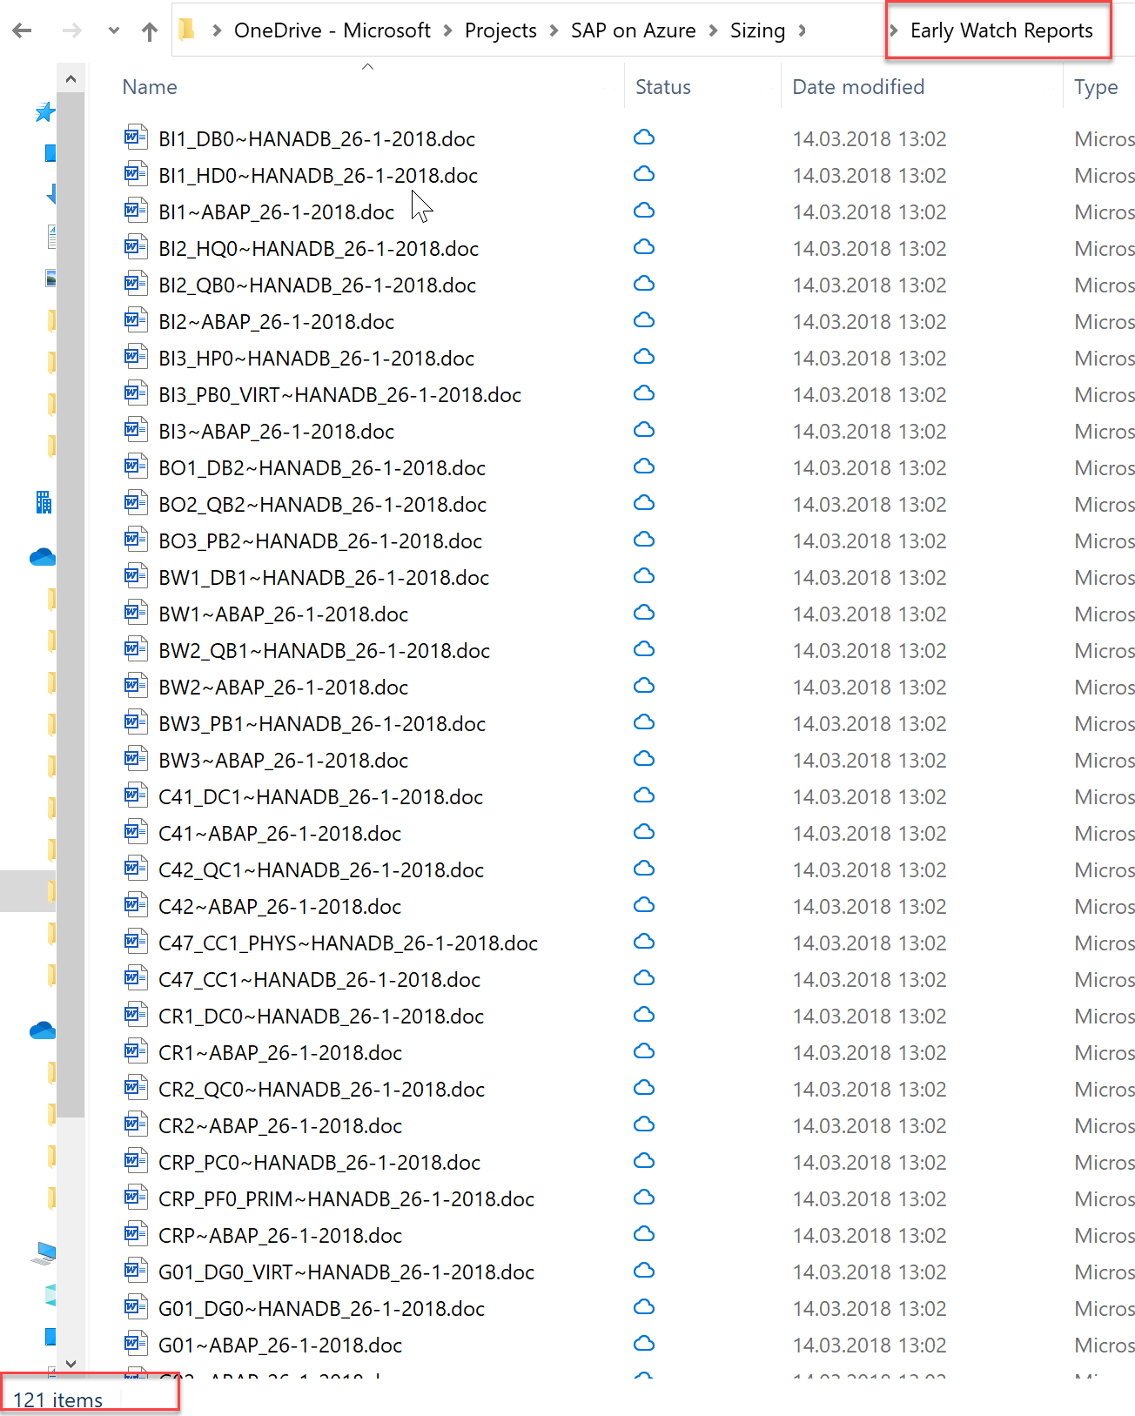
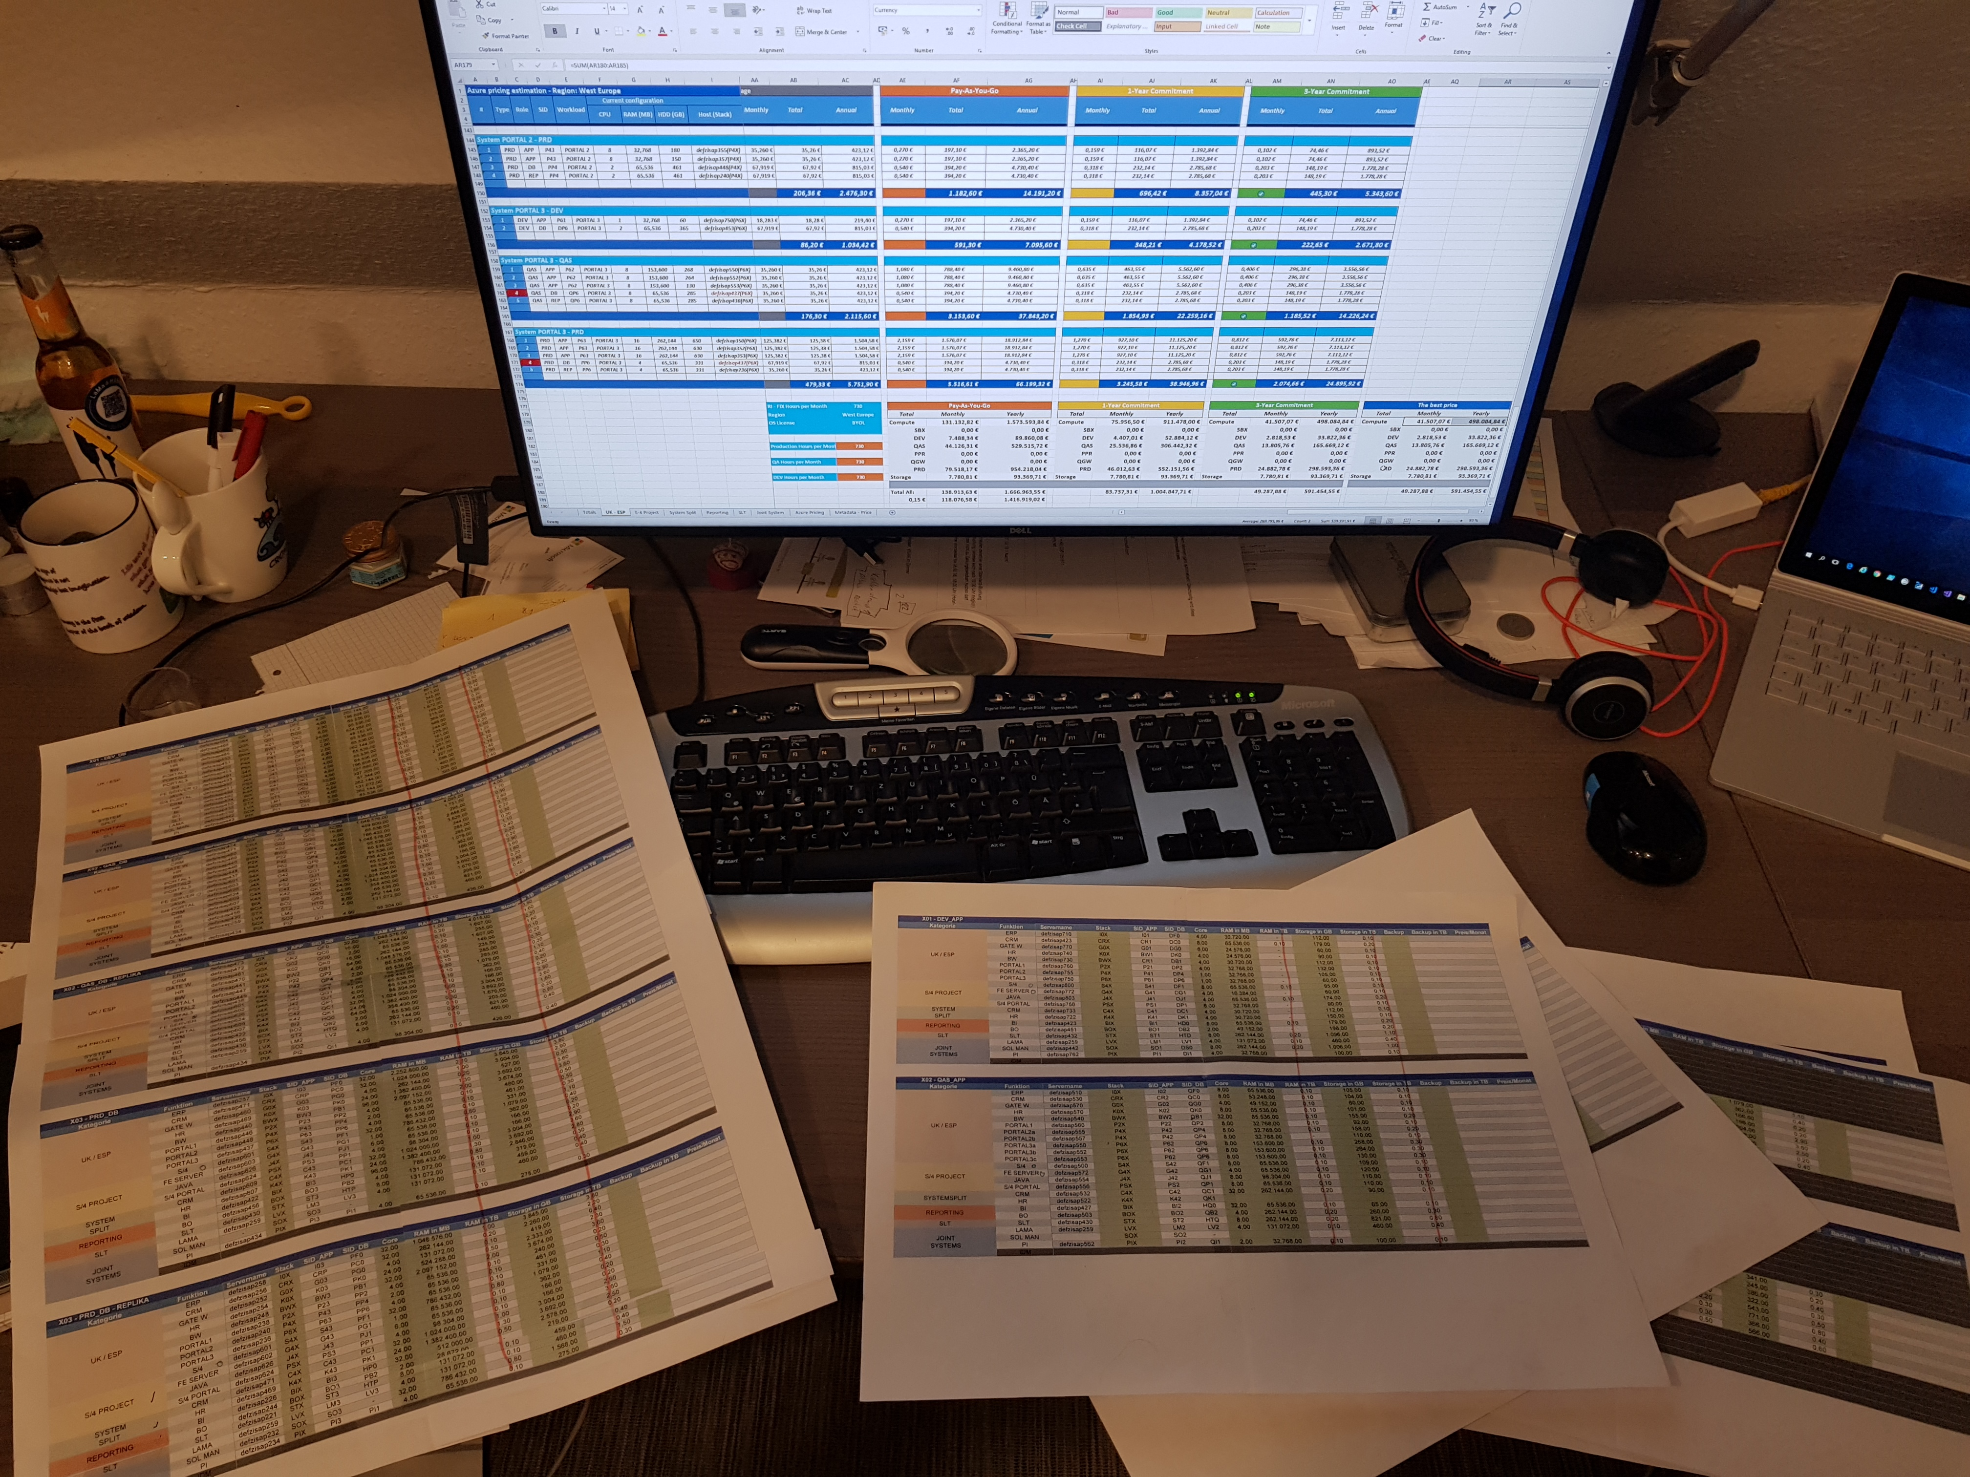
Something like…

Slide 15
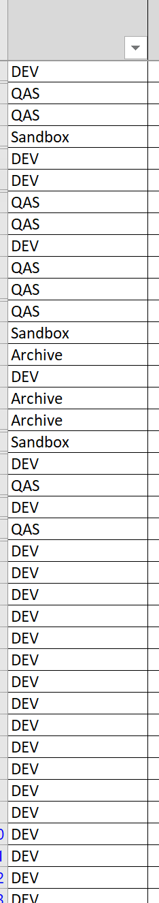
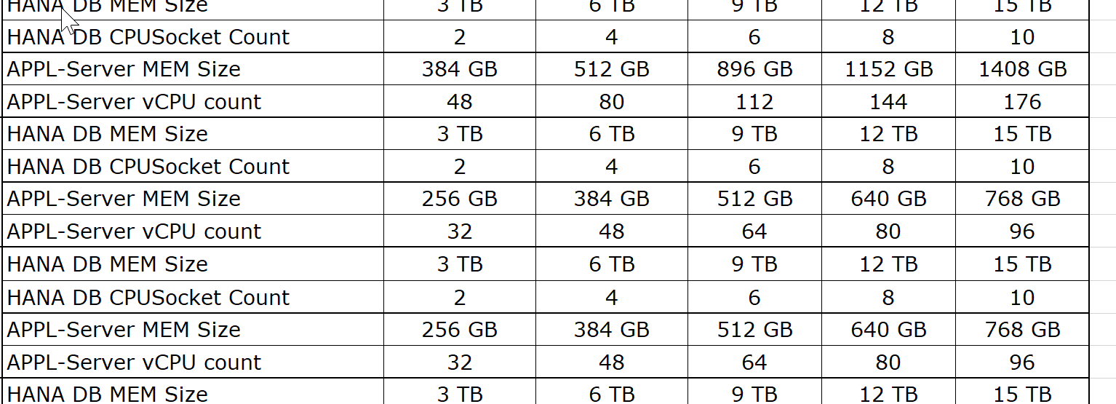
Or something like…

Slide 16
SAP on Azure project steps
Motivations
Understand motivations to move to cloud (datacenter exit, cost savings, preparation for new technical capabilities like S4/HANA Migration)
Readiness
SAP Basis staff members might feel anxious about their roles and positions as they realize a different set of skills is needed to support cloud solutions
Identify First Project
Leverage business and technical criteria to choose the first project
Sizing & Pricing
Right-Sizing, Tight-Sizing, Snoozing

Slide 17
The funny facts… about SAP on Azure
It is not… all about SAP landscapes. There are always some non-SAP applications, somewhere!
Hosted in a virtualization environment where the rules of creating new VM’s are mostly driven by… let’s see what we have free there.
Mostly are Lift-and-Shift… My TB is cheaper than your TB… Fanta vs Orange ☺

Slide 18
The cloud adoption affects the business, technology, and culture of enterprises.

Slide 19
The cloud adoption affects the business, technology, and culture of enterprises.

Slide 20
The cloud adoption affects the business, technology, and culture of enterprises.

Slide 21
Traditional thinking
Block from directly understanding the cloud to save today’s business
Customer
Cloud Custodian /
Partner responsible for Cloud environment
Customer

Slide 22



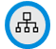


Cloud-native thinking
Removing barriers with One Microsoft approach to cloud adoption
Best practices
Templates
People
Process
Technology
Documentation
Plan
Tools
Customer
Define Strategy
Ready
Cloud Custodian /
Partner responsible for Cloud environment
Customer
Adopt
Govern & Manage
Templates
RBAC
Policies

Slide 23
Azure: Hybrid
The only consistent, comprehensive hybrid cloud
Azure
services
Azure
DevOps
Azure data services
Azure Active Directory
Azure security & management
Developer Platform
Data
Platform
Security & Management
DevOps
Identity
Azure Stack
Azure
DevOps
SQL Server, MySQL,
PostgreSQL, NoSQL
Active Directory
Azure security & management

Slide 24
Customer cloud journey
App
Migration & Modernization
Cloud-native
SaaS
On-premises
Data
Rehost
Refactor
Rearchitect
Rebuild/New
Replace
Infrastructure
Virtual Machines
Containers
App, Data, & AI Services
Security and Management
DevOps

Slide 25
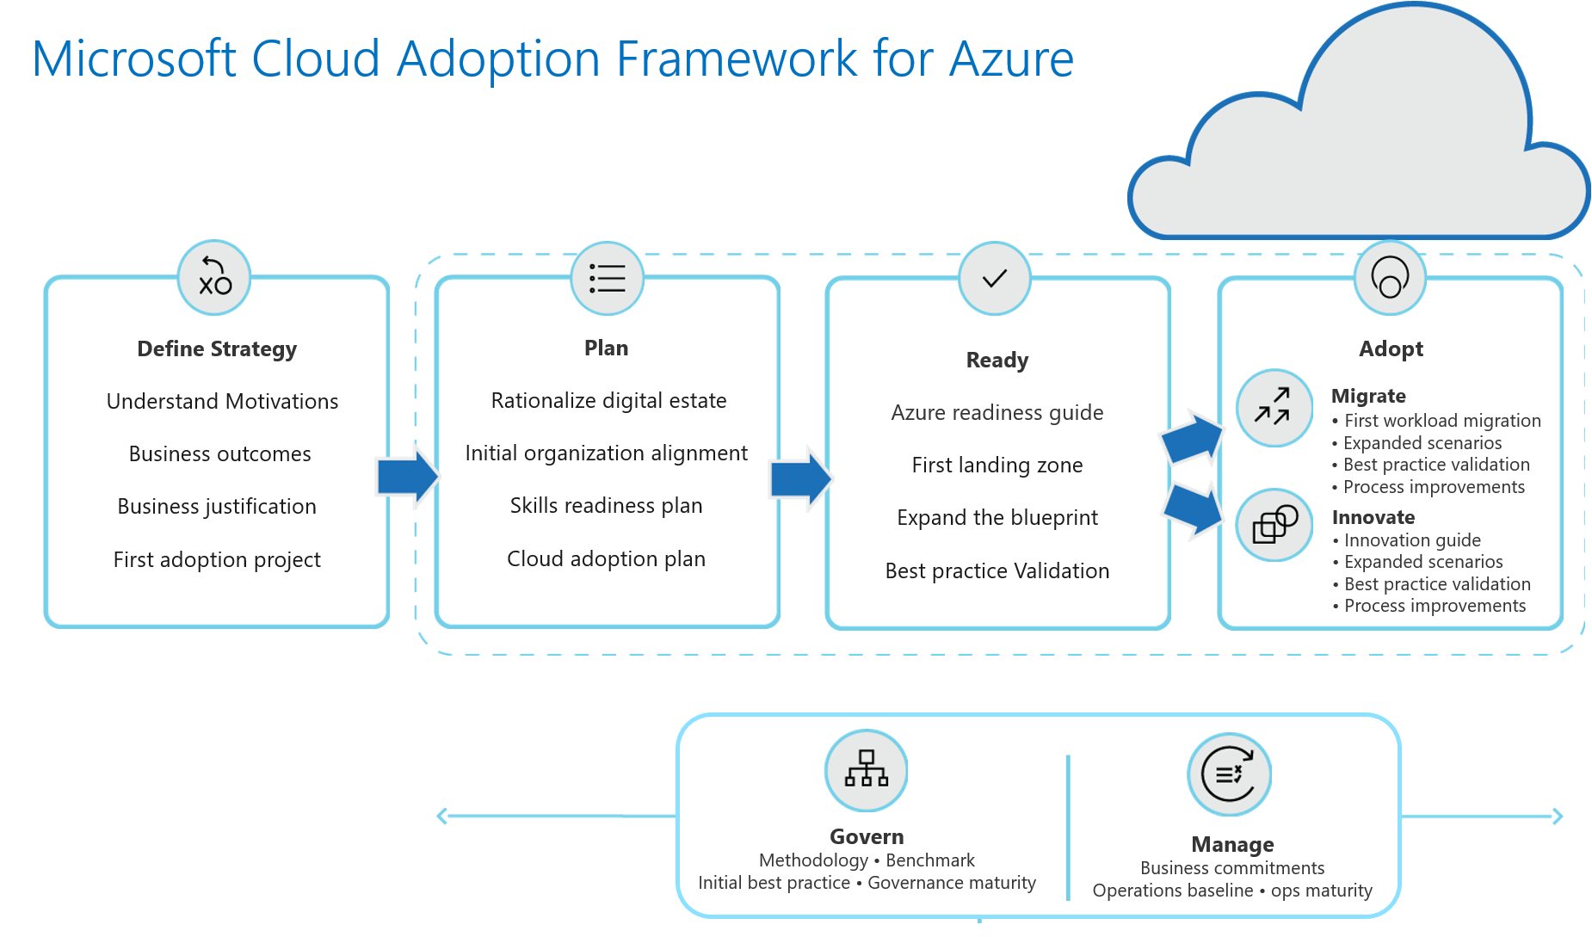

Slide 26
Software and hardware refresh
Security threats
Urgent capacity needs
Compliance
Quickly integrate acquisitions
Application innovation
Migration & modernization triggers
Software end of support
Datacenter contracts expiry
Notes:
2 patterns:
Look for and listen deeply to your customers’ migration/modernization triggers. That will help you position appropriate urgency around migration.
Situations like end of support, DC lease expiry, acquisition integration signal time-bound deadlines.
App innovation might be tops down driven and needs to be dealt with strategically.

Slide 27
Get started at no cost: Built-in tools at each stage
Pre-migration
During migration
Post-migration
Azure Migrate
Azure Site Recovery
Azure Cost Management
Notes:
Inline offers?

Slide 28
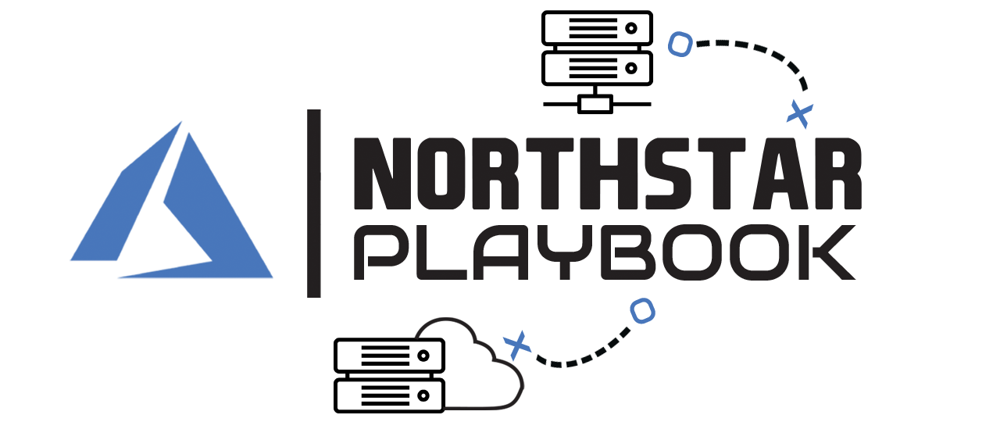
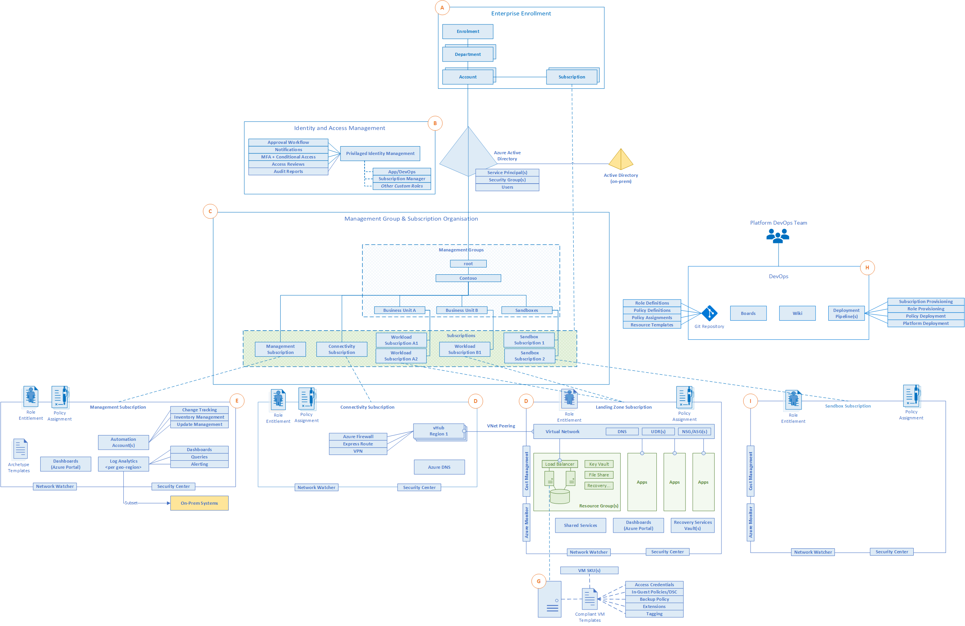
Design Guidelines
A - Enterprise Enrolment and Azure AD Tenants
B - Identity and Access Management
C - Management Group and Subscription Organisation
D - Network Topology and Connectivity
E - Management and Monitoring
F - Business Continuity and Disaster Recovery
G - Security, Governance and Compliance
H - Platform Automation and DevOps

Slide 29
Resiliency in Azure for your big (SAP) environment

Slide 31

Types of failures you need Resilience from
Improved availability
Build and run highly-available applications with near-zero RPO/RTO
Implement disaster recovery plan with data residency and minimal RPO/RTO
Customer
need
Premium Storage
Availability Sets
Availability Zones
Azure Site Recovery / Region Pairs
Region 1
Region 2
Region 1
Zone 1
Data center 1
Single VM
Data center 1
Zone 1
Zone 1
Data center 1
Zone1
Data center 2
Zone 2
Zone 3
Zone 2
Zone 2
Zone 3
Zone 3
Infrastructure
(applications and data)
Blast radius
Single point of failure
Hardware failure
Network/Power outage
Natural Disaster
Scope of Impact
Accidental data loss
Data corruption
Ransomware
Rogue admin
Data
(stateful)
Go back point in time to restore the healthier version of data
Backup
Notes:
So we have seen how Resilience is not about avoiding any failure but bouncing back from one. Let’s look at some typical failures that may lead to a downtime for your application –
This trapezium shows the degree of impact that a failure can potentially cause. So while, a power or a network outage may impact a datacenter of a multiple data centers in a zone; something more catastrophic like a flood or earthquake can take down the entire region. All these failures primarily impact your infrastructure (which comprises of both applications and the data).
There’s one thing that is common across though, no matter what your deployment is (you can be running the entire set up in a single region vs spread across zones), you will most likely have data; data which is stateful; data which you would need to go back to.
The failures impacting this data look like these. And to draw a parallel, these too in some sense have varying degree of impact of these failures on the data; while accidental deletion may lead to losing a file or folder; a rogue admin can wipe off not only your data but also your backups.
Thus, we need to build resilience against all these failure and the azure services can help us achieve just that.
Opt for Premium storage that allows for 99.5% availability in case of a single VM deployment.
Up your Resilience game with High Availability structures; deploy your architecture in Availability sets or AZs to get SLA up to 99.99%. HA should be preferred for your mission critical apps which have very stringent RPO and RTO requirements (almost real time).
Go one step head to further isolate your VMs by making used of paired regions in azure. The recently previewed feature for storage account failover when configured for GRS also is a subset of this solution.
But none of them still covers you for data failures; and that’s because all of these deployments are almost constantly syncing data across; so if any data corruption happens and I need to go back in time to say a couple of days, I need to have backed-up that version. Hence, we have Backup.

Slide 32
Enterprise-Grade VM Availability, SLAs & DR
VM SLA
VM SLA
VM SLA
Multi-region
99.9%
99.95%
99.99%
Data Resiliency
Data residency
Single VM
Availability sets
Availability zones
Region pairs
Easier lift and shift
Protecting against failures within datacenters
Protection from entire datacenter failures
Regional protection within Data Residency Boundaries

Slide 33

Single Instance Virtual Machine (99.9% SLA)
Business need
Protect applications and data from hardware and software update failures.
Azure Solution
For any Single Instance Virtual Machine using premium storage for all Operating System Disks and Data Disks, we guarantee you will have Virtual Machine Connectivity of at least 99.9%.
Application Layer | Azure Service | SLA
Compute | Availability Sets Virtual Machine Scale Sets | 99.95%
Storage – Disks | Managed Disks | XX
Storage – Blob/Queue/ File/Table | LRS | XX
Networking | IP Address Basic Load Balancer
Data | SQL Managed Instance IaaS SQL Server
Fault Domain
Fault Domain
Rack
Rack
Virtual Machine
Virtual Machine
SAP 1
SAP 1
Virtual Machine
Virtual Machine
HANA
HANA
Fault Domain: a logical group of underlying hardware that share a common power source and network switch, within a datacenter.

Slide 34
Single Instance Virtual Machine (99.9% SLA)
Business need
Protect applications and data from hardware and software update failures.
Azure Solution
For any Single Instance Virtual Machine using premium storage for all Operating System Disks and Data Disks, we guarantee you will have Virtual Machine Connectivity of at least 99.9%.
Application Layer | Azure Service | SLA
Compute | Availability Sets Virtual Machine Scale Sets | 99.95%
Storage – Disks | Managed Disks | XX
Storage – Blob/Queue/ File/Table | LRS | XX
Networking | IP Address Basic Load Balancer
Data | SQL Managed Instance IaaS SQL Server
Fault Domain
Fault Domain
Rack
Rack
Virtual Machine
Virtual Machine
SAP 1
SAP 1
Virtual Machine
Virtual Machine
HANA
HANA
Fault Domain: a logical group of underlying hardware that share a common power source and network switch, within a datacenter.

Slide 35
Resilience pattern: High-Availability (99.95% SLA)
Business need
Protect applications and data from hardware and software update failures.
Build and run highly-available active/active applications with synchronous replication.
Latency sensitive applications with <1ms VM-to-VM RTT.
Azure Solution
An Availability Set is a logical grouping to ensure virtual machines are isolated from each other within an Azure datacenter.
Azure platform distributes VMs within an Availability Set across FDs and UDs providing high-availability.
Application Layer | Azure Service | SLA
Compute | Availability Sets Virtual Machine Scale Sets | 99.95%
Storage – Disks | Managed Disks | XX
Storage – Blob/Queue/ File/Table | LRS | XX
Networking | IP Address Basic Load Balancer
Data | SQL Managed Instance IaaS SQL Server
Fault Domain
Fault Domain
Rack
Rack
Virtual Machine
Virtual Machine
App. Server Availability Set
SAP 1
SAP 1
Virtual Machine
Virtual Machine
DB Availability Set
HANA
HANA
Fault Domain: a logical group of underlying hardware that share a common power source and network switch, within a datacenter.
Update Domain: a logical group of underlying hardware that can undergo maintenance or be rebooted at the same time.

Slide 36
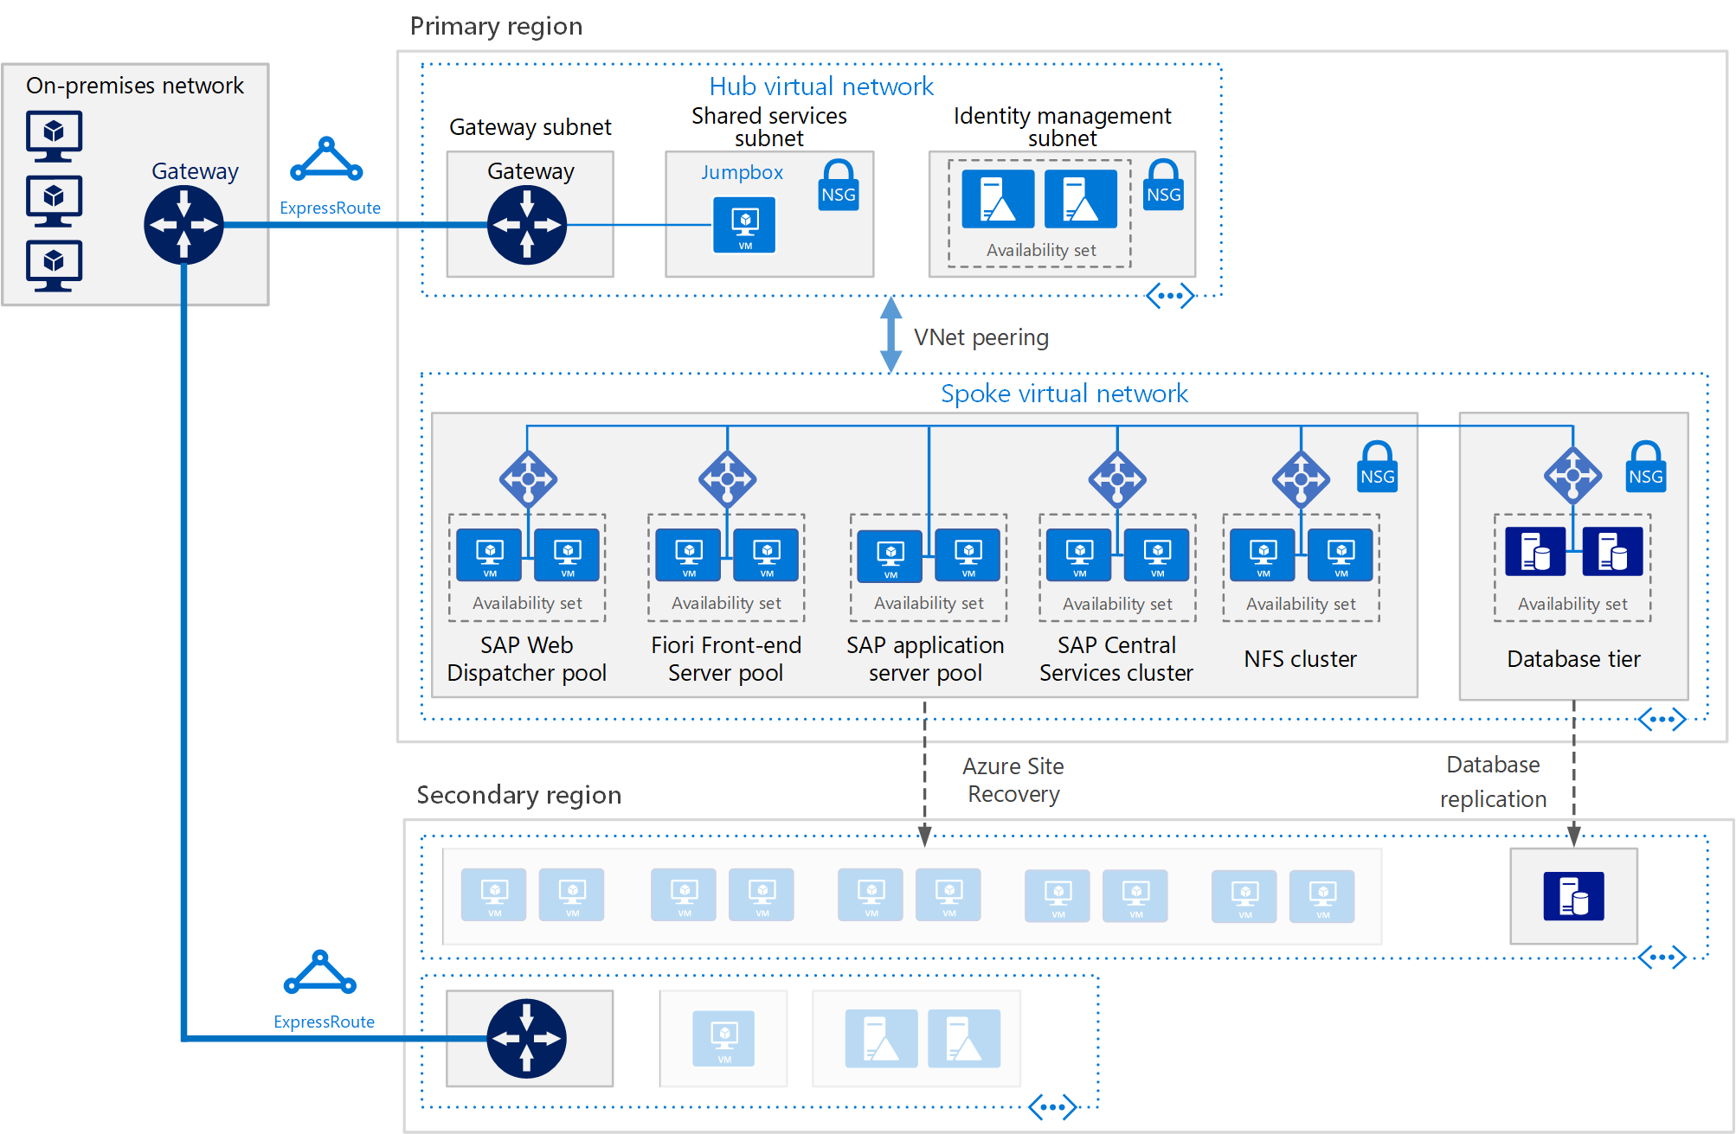
SAP S/4HANA virtual machines on Azure
aka.ms/SAPonAzure-Architecture

Slide 37

Resilience pattern: High-Availability (99.99% SLA)
Business need
Protect applications and data from datacenter and software update failures.
Build and run highly-available active/active applications with synchronous replication.
Azure Solution
Availability Zones are unique physical locations within an Azure region.
Each Zone consists of one or more datacenters with independent power, cooling and networking.
Availability Zones are designed to meet <2ms VM-to-VM RTT within an Azure region.
Application Layer | Azure Service | SLA
Compute | Availability Sets Virtual Machine Scale Sets | 99.95%
Storage – Disks | Managed Disks | XX
Storage – Blob/Queue/ File/Table | LRS | XX
Networking | IP Address Basic Load Balancer
Data | SQL Managed Instance IaaS SQL Server
Region
Availability Zone 1
Availability Zone 2
Availability Zone 3

Slide 38
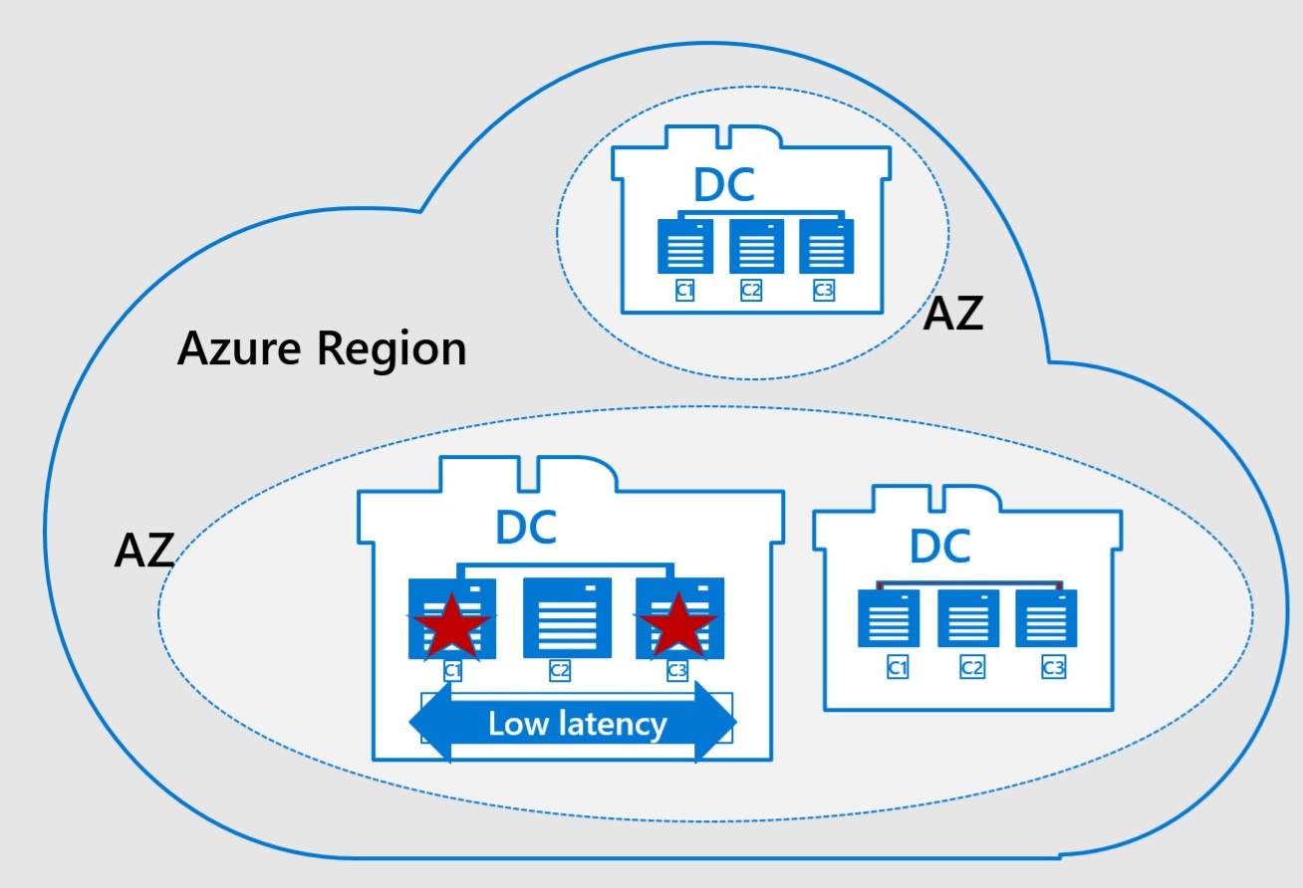
Availabilty Zones - Azure Proximity Placement Groups
Problem
Application Layer and DBMS layer should be in close proximity​
Very difficult to achieve in some of the Azure regions
Solution​
Create logical solution like AvSets that has ​no state up to the point where first ​VM gets deployed into it​
First VM throws the anchor into a DC​
All subsequent new VMs deployed into PPG​ end up in same DC​
Works for VMs, VMSS and HANA Large Instances​
Already used to deploy multiple customers in Production​
Application Layer | Azure Service | SLA
Compute | Availability Sets Virtual Machine Scale Sets | 99.95%
Storage – Disks | Managed Disks | XX
Storage – Blob/Queue/ File/Table | LRS | XX
Networking | IP Address Basic Load Balancer
Data | SQL Managed Instance IaaS SQL Server

Slide 39
SAP S/4HANA virtual machines on Azure
aka.ms/SAPonAzure-Architecture

Slide 41
Availability Zone 1
Active Zone
Availability Zone 2

Slide 42
Azure Architecture Center

Slide 43
Q&A

Slide 44
Thank you!
Robert Boban @ LinkedIn

